Slide 1
Serverless Architecture with Azure Funcitons
by Juanjo Cerezuela
@PliyoSan

Slide 2


Slide 3
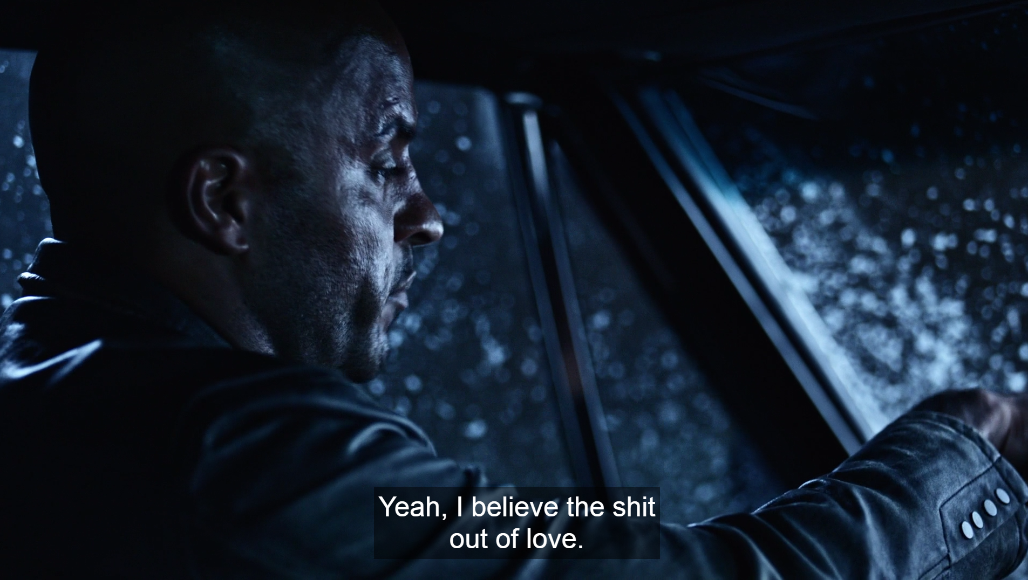

Slide 4


Slide 5
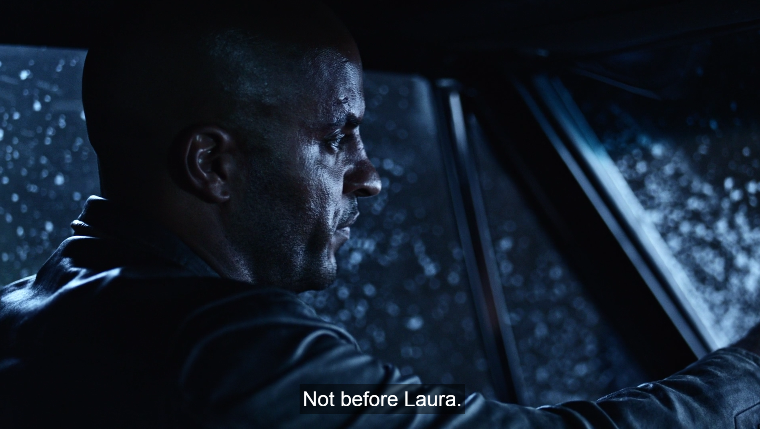

Slide 6


Slide 7


Slide 8
BUT THAT’S NOT WHAT WE CAME TO TALK ABOUT

Slide 9
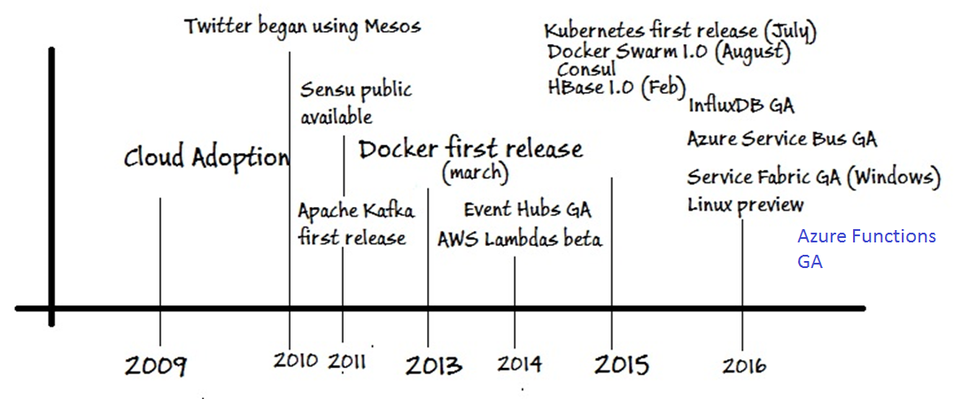
Where are we coming from?

Slide 10
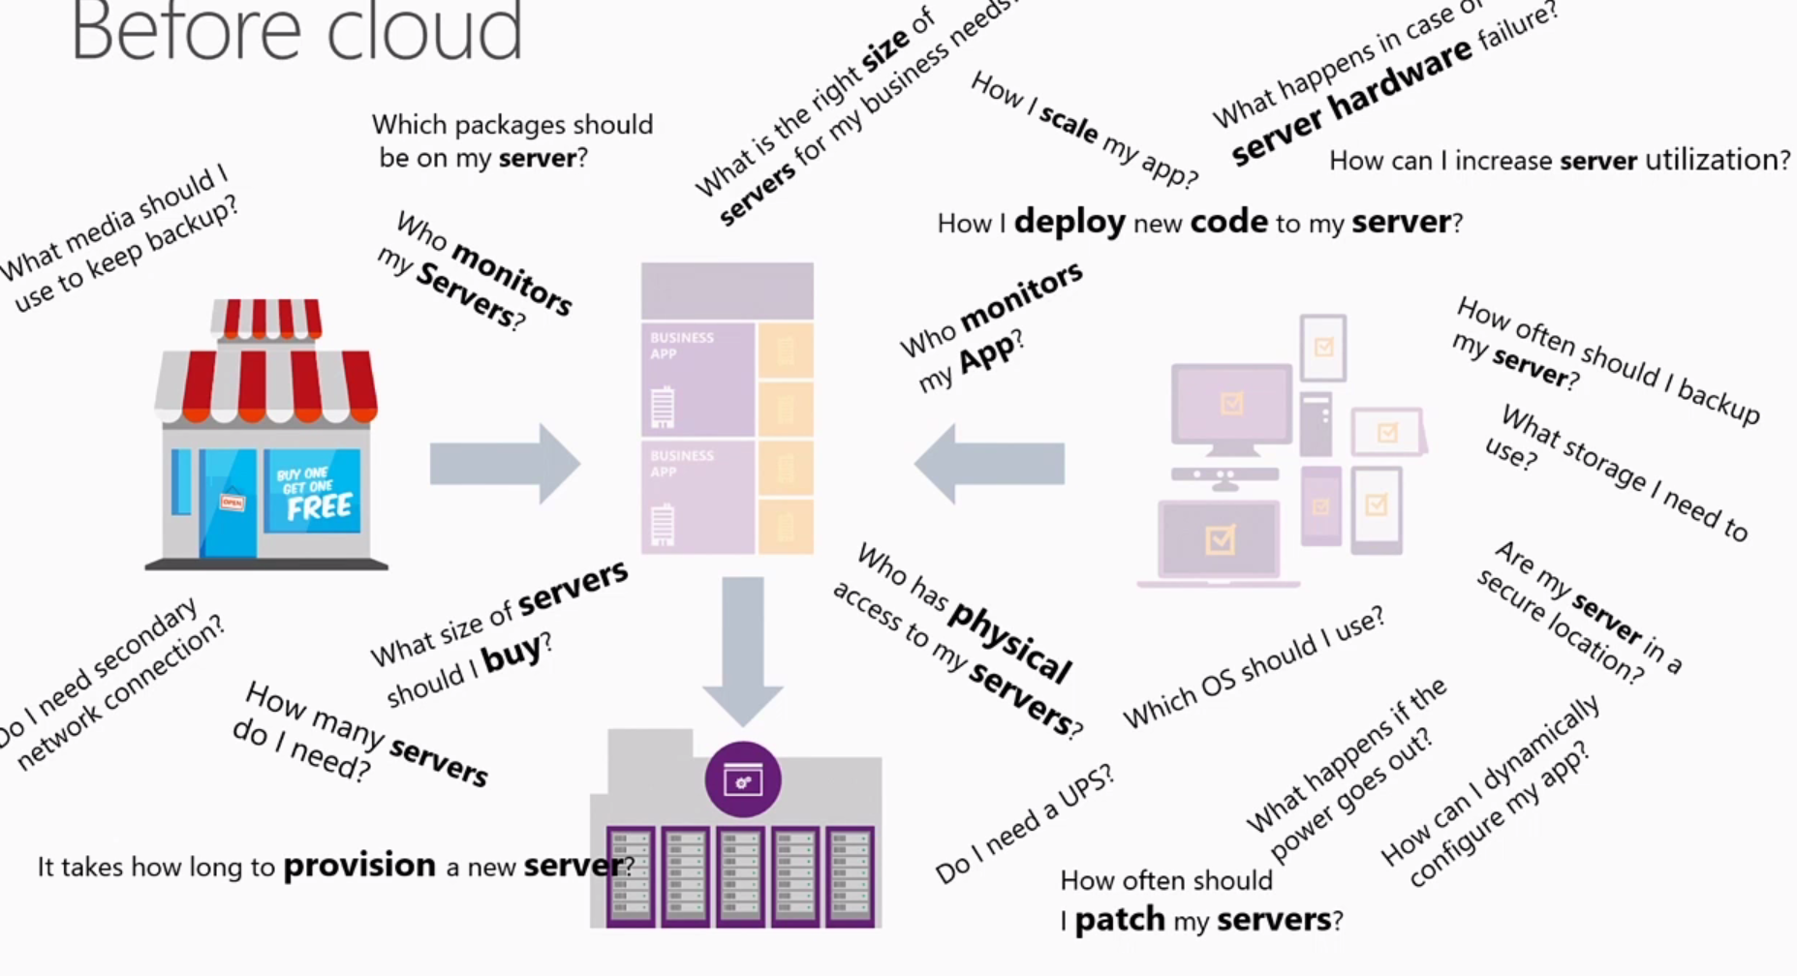
Where are we coming from?
Source: Building serverless applications With Azure

Slide 11
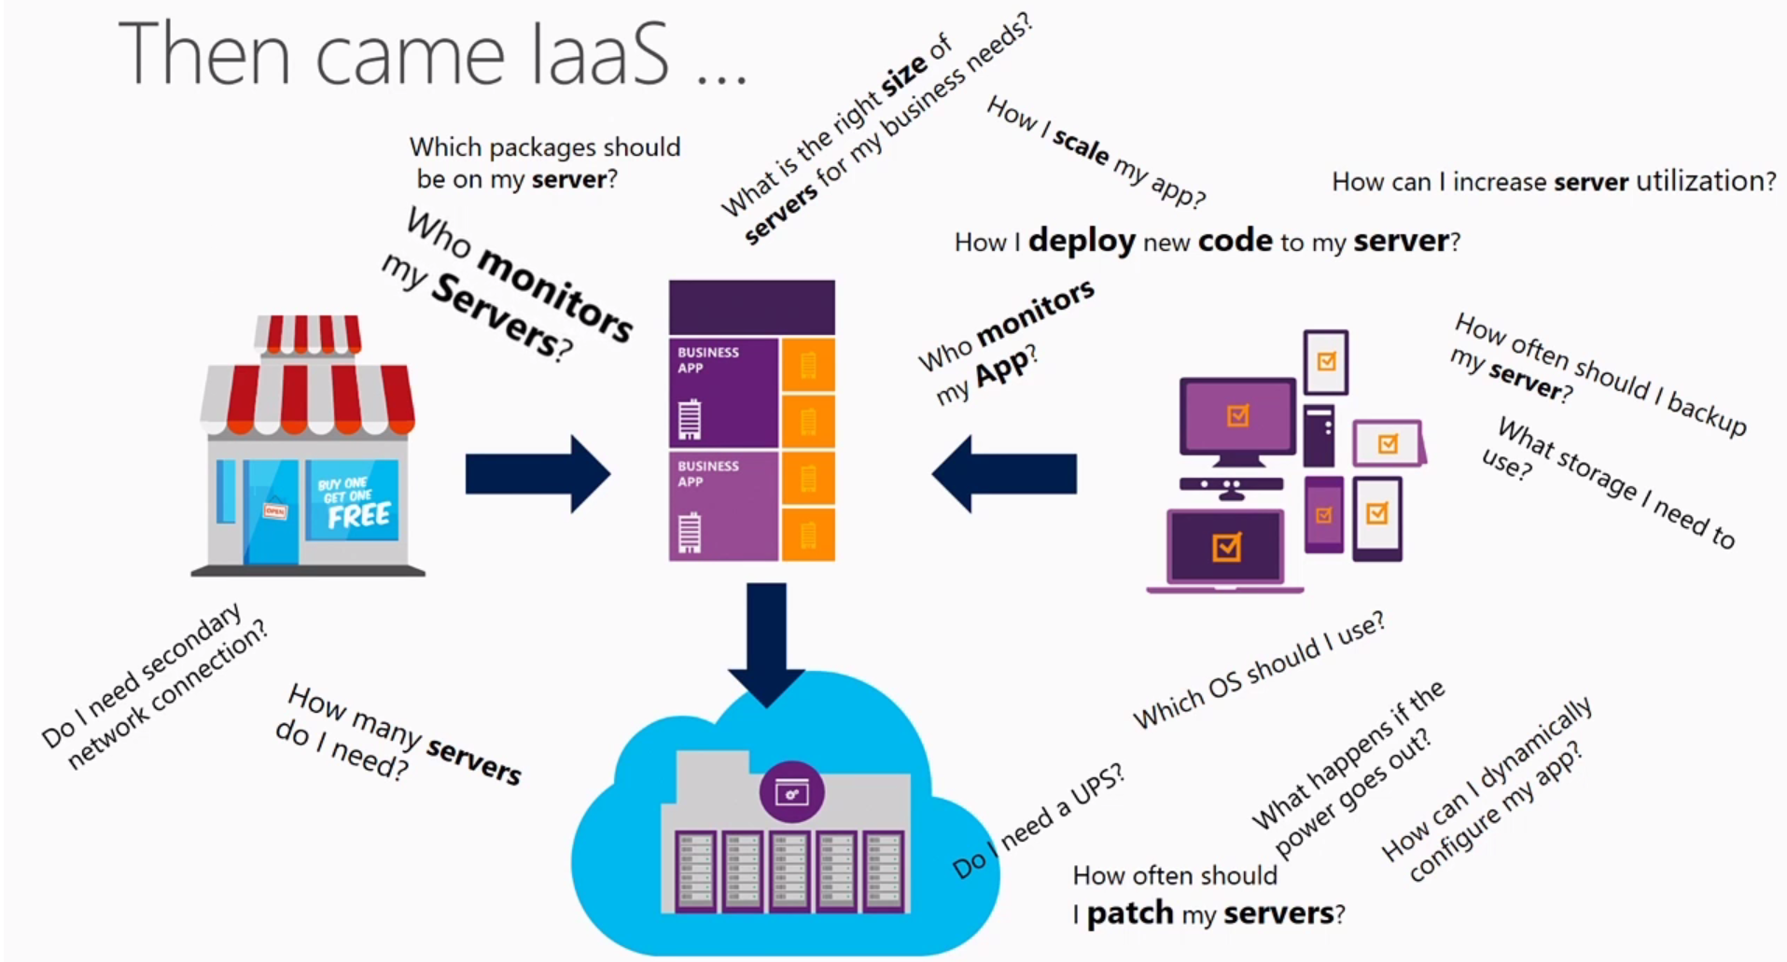
Where are we coming from?
Source: Building serverless applications With Azure

Slide 12
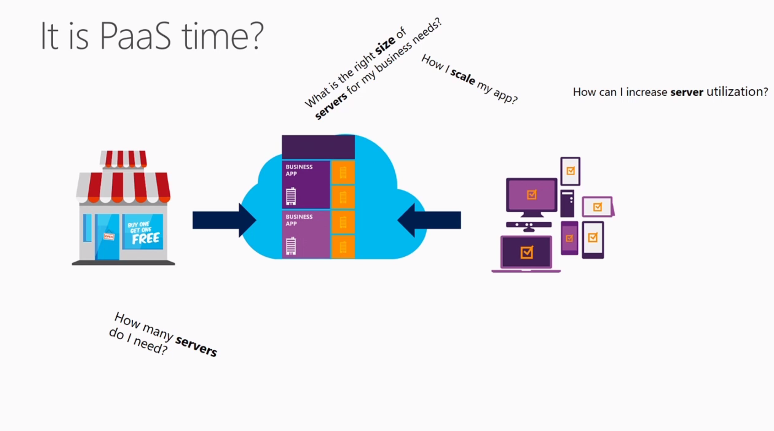
Where are we coming from?
Source: Building serverless applications With Azure

Slide 13



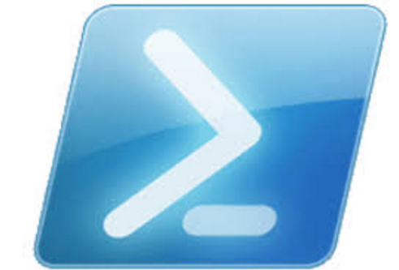
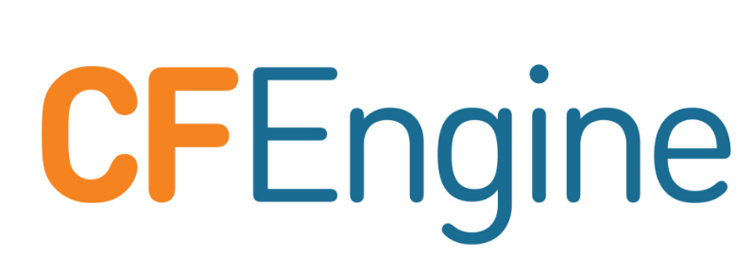
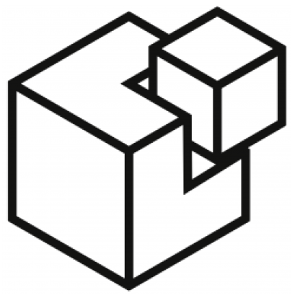

Where are we coming from?

Slide 14
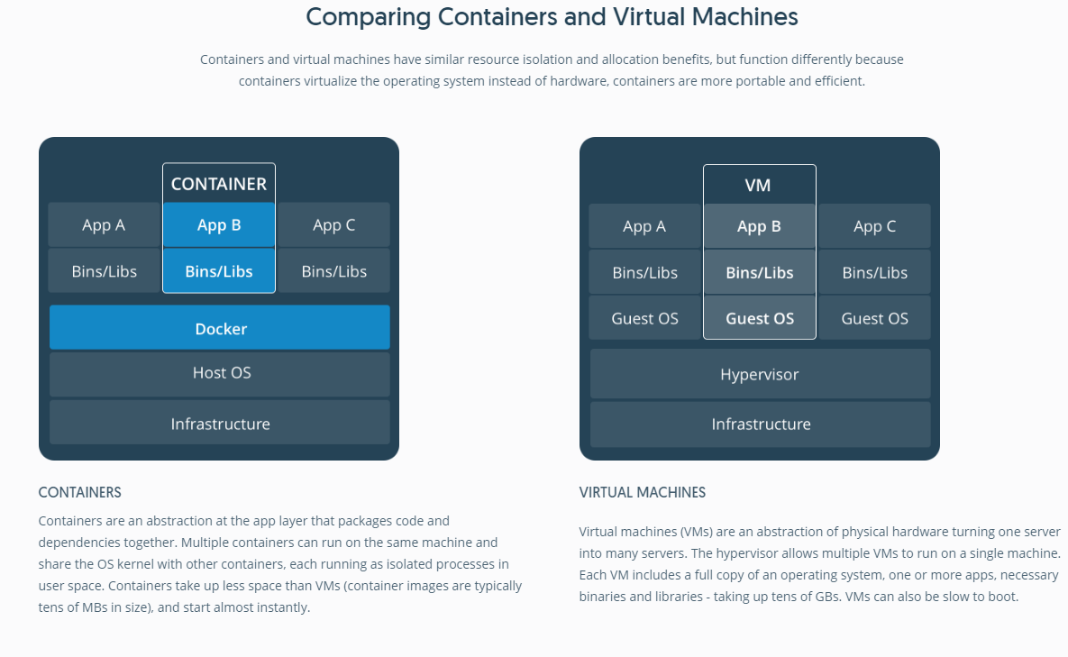
Source: What is a Container?

Slide 15
What is Serverless?
"Serverless Computing" doesn't really mean there's no server. Serverless means there's no server you need to worry about. That might sound like PaaS, but it's higher level that than.
- Scott Hanselman.

Slide 16
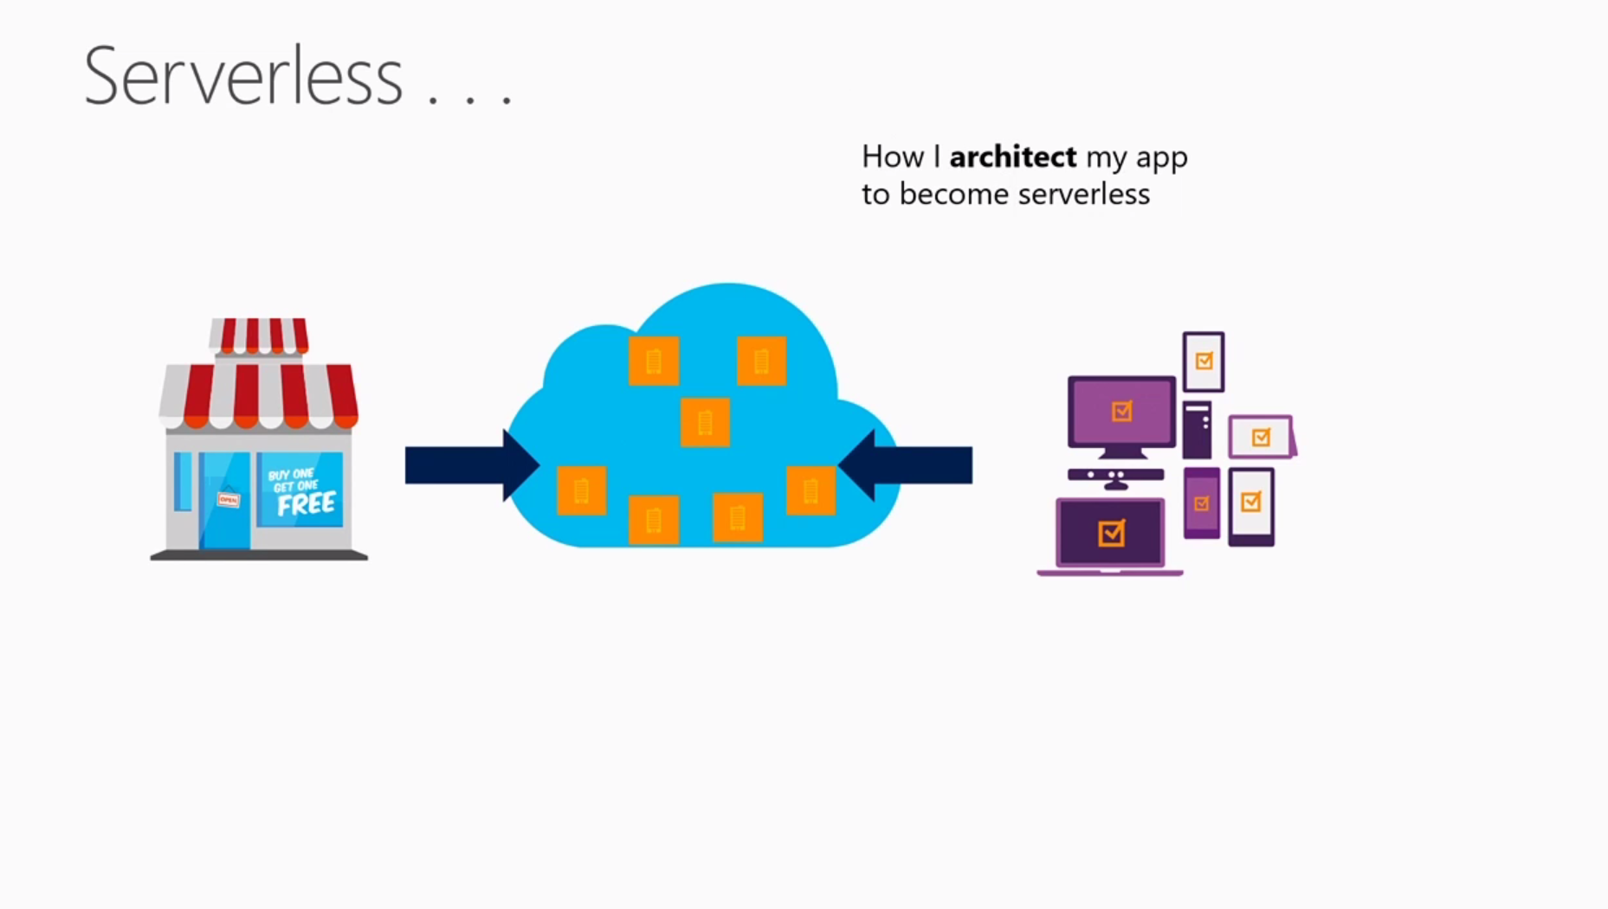
What is Serverless?
Source: Building serverless applications With Azure

Slide 17
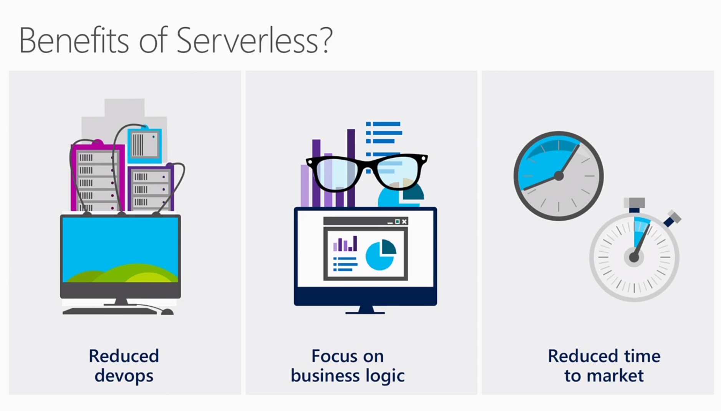
What is Serverless?
Source: Building serverless applications With Azure

Slide 18
What is Serverless?
All design is about tradeoffs. On the one hand, serverless applications can be made to scale more easily.
On the other hand, the conceptual overhead of splitting a single application into something that woven from a fabric of services is significant and increases with the number and variety of services used. Lastly, they are easier to operate and maintain. Third-party services spend significant resources on security, availability, scaling and performance. It falls on development teams to design for failure.
Source: https://martinfowler.com/bliki/Serverless.html

Slide 19
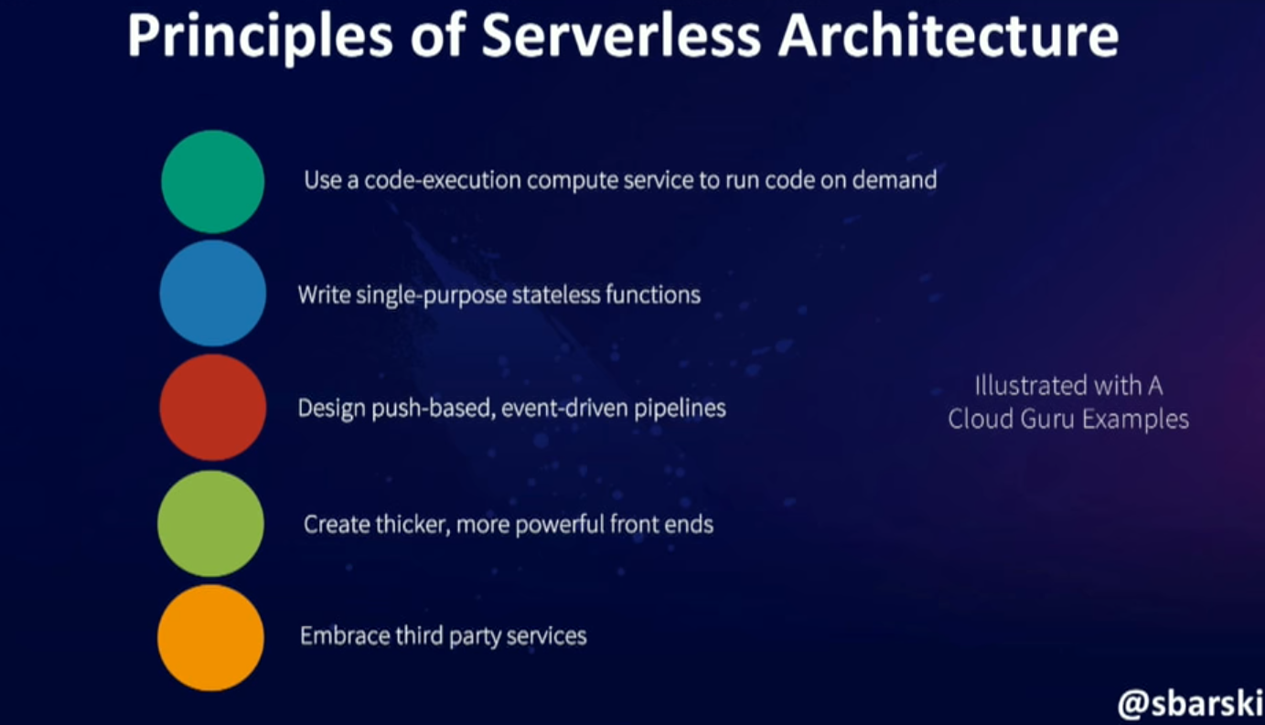
What is Serverless?
Source: Serverless: The future of Software Architecture – Peter Sbarski

Slide 20
What is Serverless?
1. Use a compute service to execute code on demand. Your main focus is to solve an interesting problem. You only pay for the time that executes (miliseconds, not hours).
Source: Serverless: The future of Software Architecture – Peter Sbarski

Slide 21
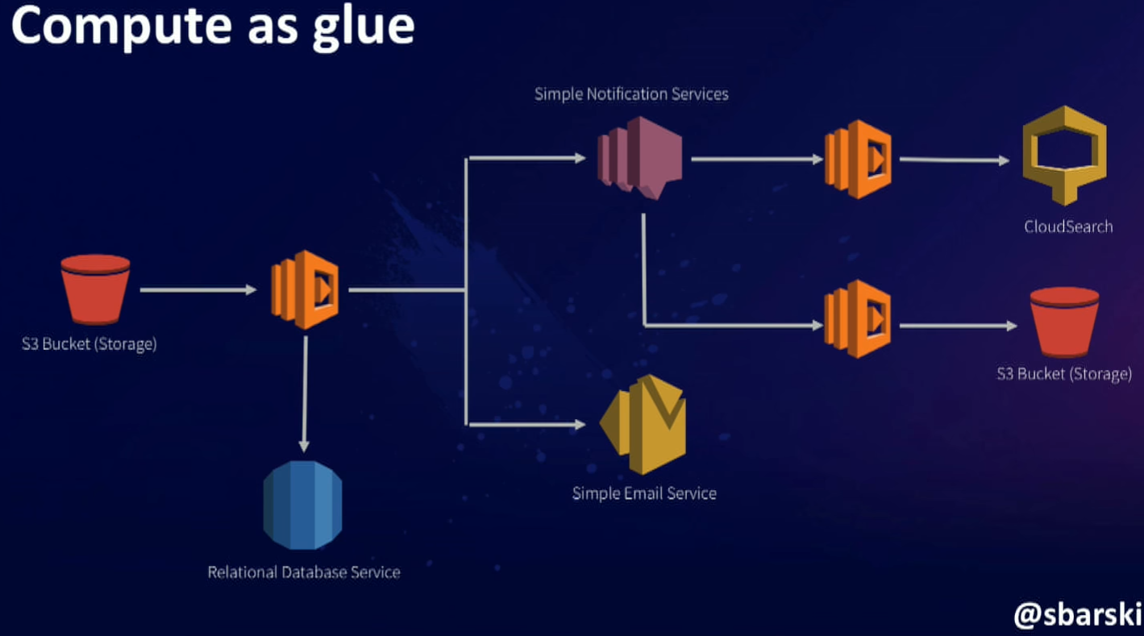
What is Serverless?
Source: Serverless: The future of Software Architecture – Peter Sbarski

Slide 22
What is Serverless?
2. Write single purpose function. A function that does one thing is more robust and easy to manage. Write stateless. No resources will survive.
Source: Serverless: The future of Software Architecture – Peter Sbarski

Slide 23
What is Serverless?
3. Design push based event driven pipelines. In event driven pipelines, you kick off an event, and that event continuous to propagate further. Ex: Write a message -> Consume the message -> Deserialize -> Write it back to another queue -> Stream Analytics can consume it.
Source: Serverless: The future of Software Architecture – Peter Sbarski

Slide 24
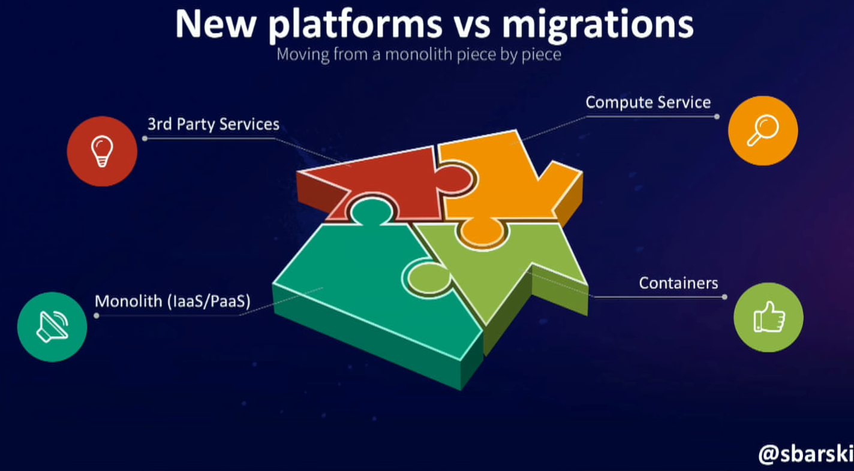
What is Serverless?
Source: Serverless: The future of Software Architecture – Peter Sbarski

Slide 25
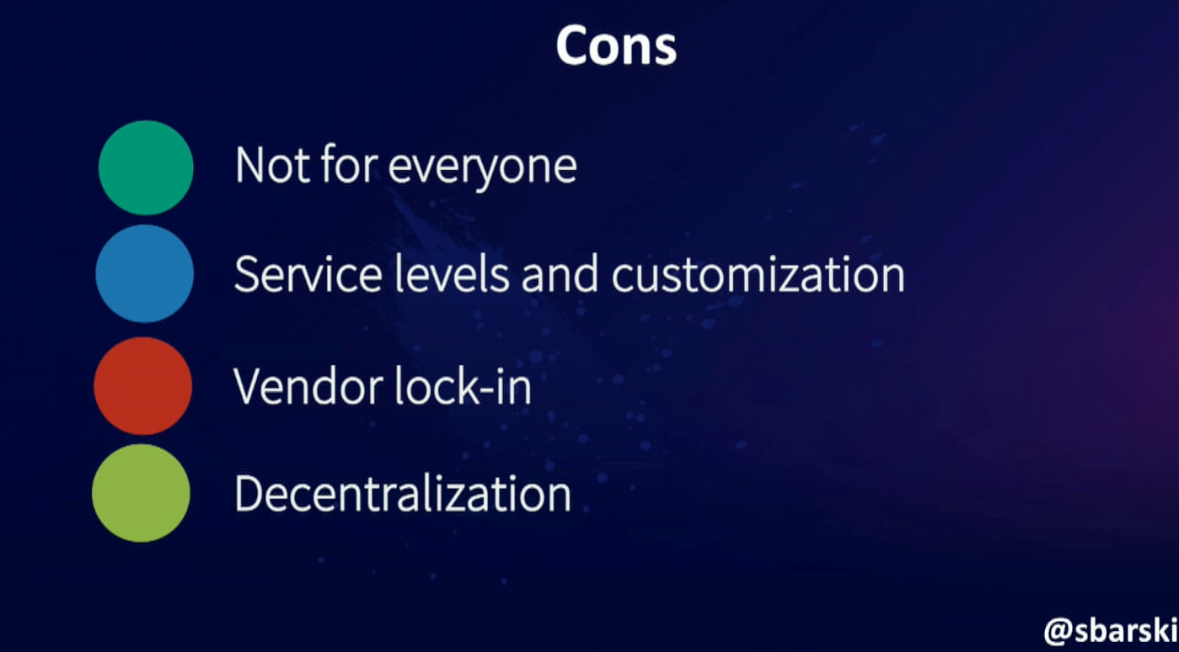
What is Serverless?
Source: Serverless: The future of Software Architecture – Peter Sbarski

Slide 26
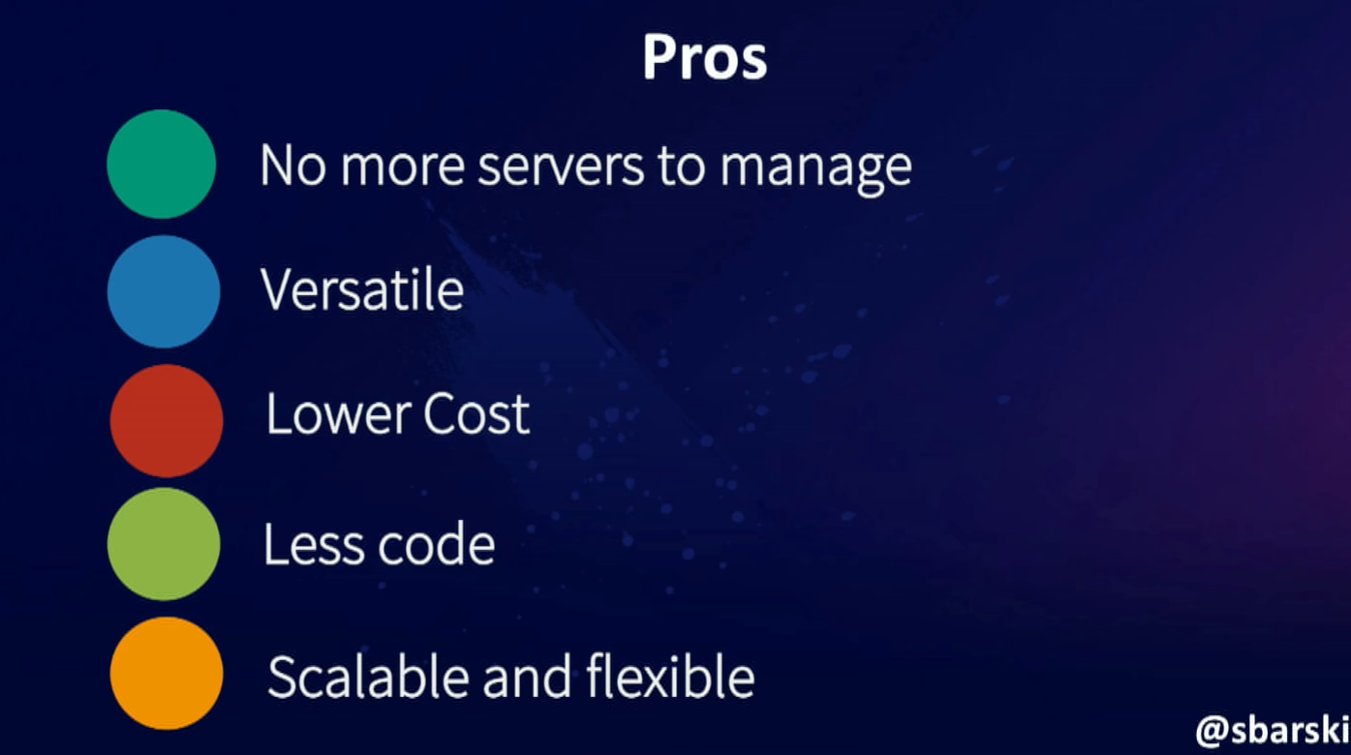
What is Serverless?
Source: Serverless: The future of Software Architecture – Peter Sbarski

Slide 27
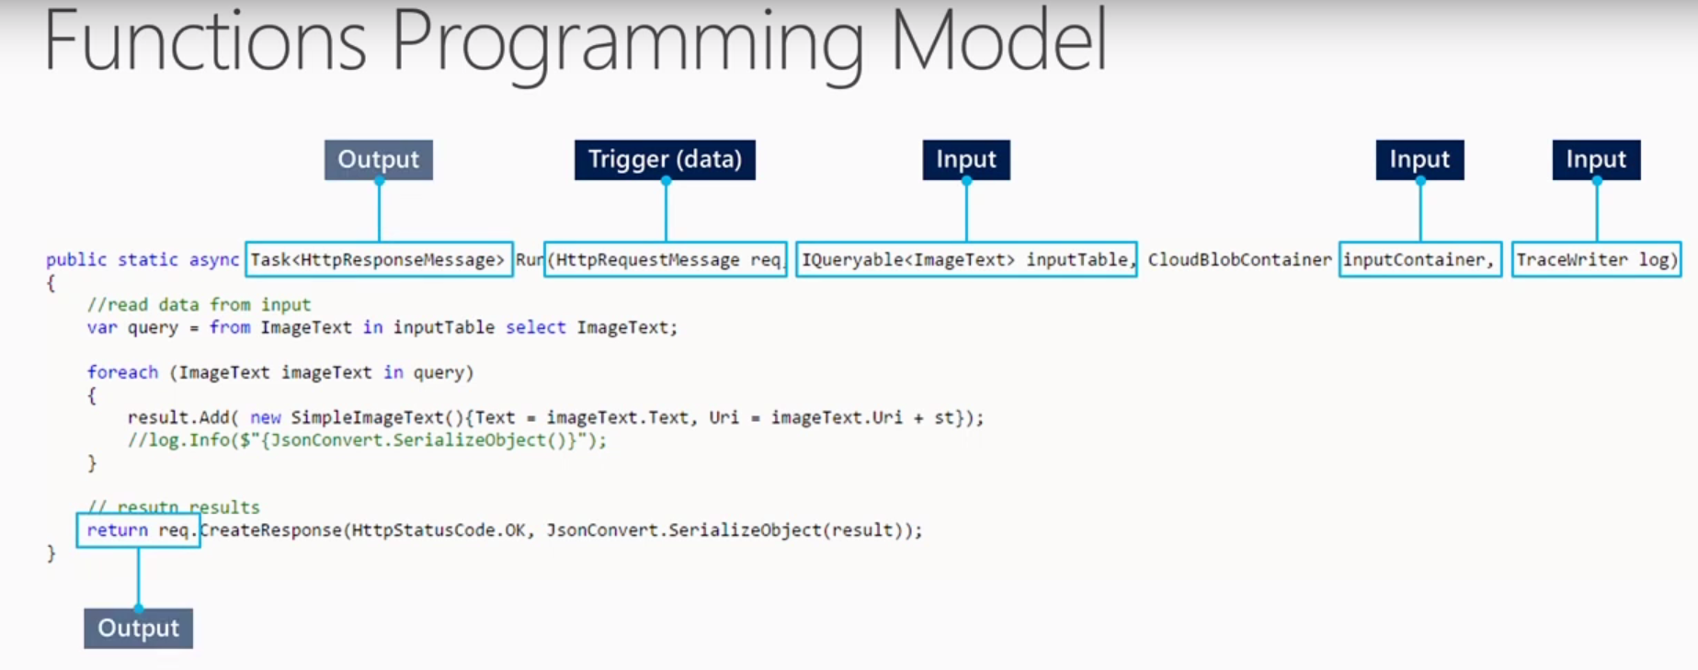
Azure Functions
Source: Building serverless applications With Azure

Slide 28
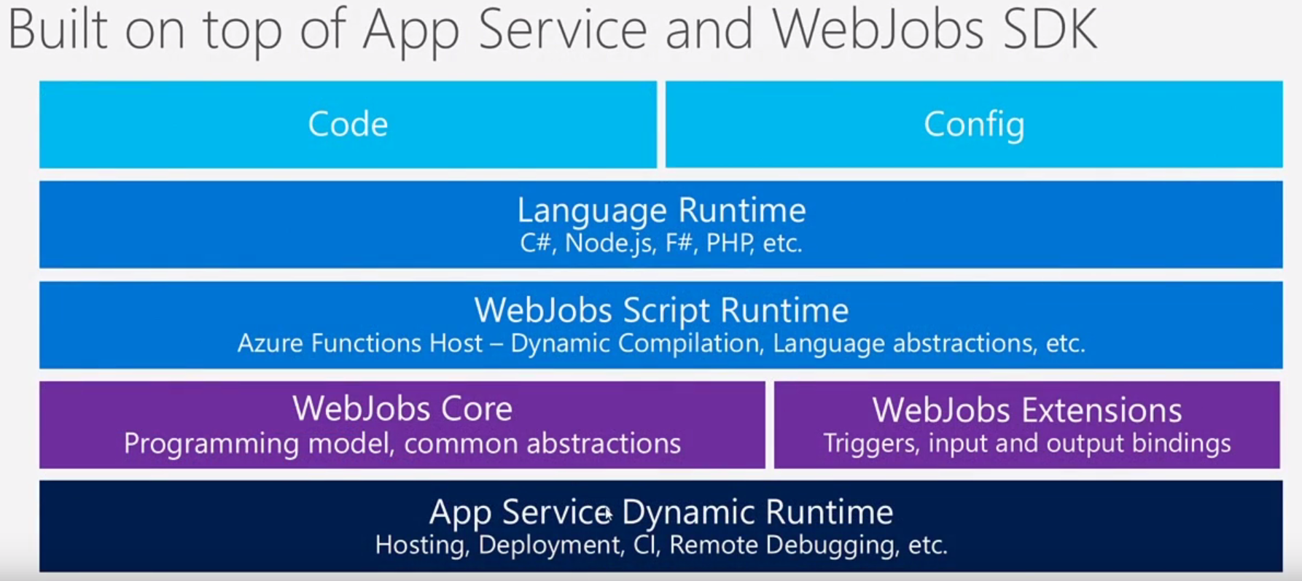
Azure Functions
Source: Building serverless applications With Azure

Slide 29
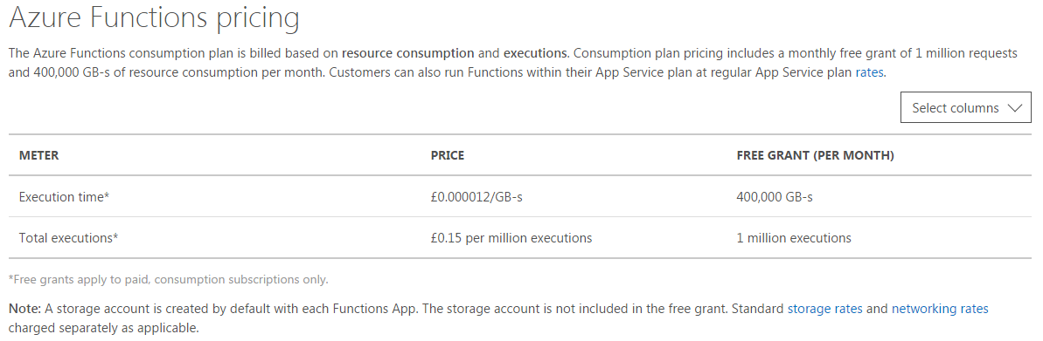
What is Serverless?
Source: Azure Functions Pricing

Slide 30
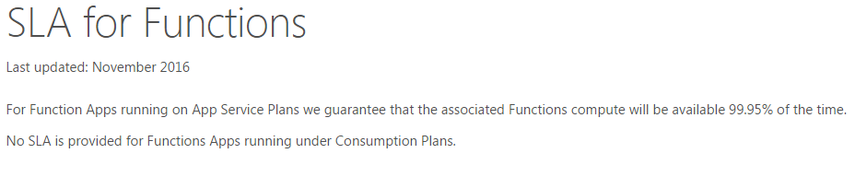
What is Serverless?
Source: Azure Functions Pricing

Slide 31
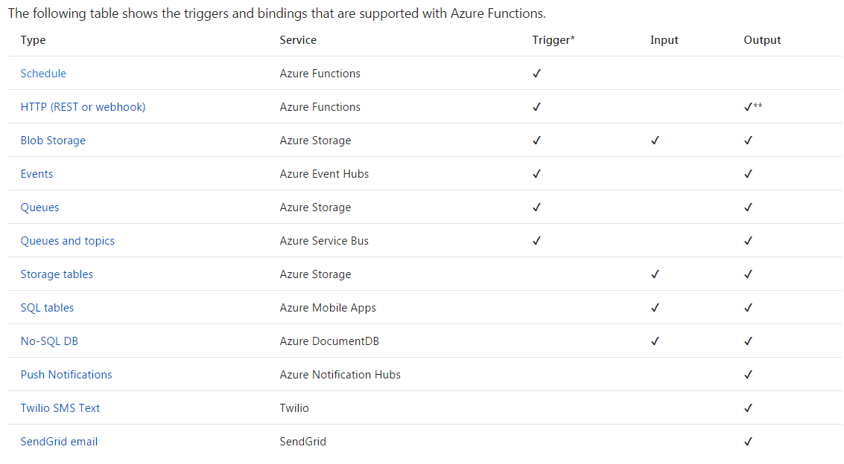
Types of functions
Source: Azure Functions Pricing

Slide 32
Types of functions
Source: Azure Functions Pricing

Slide 33
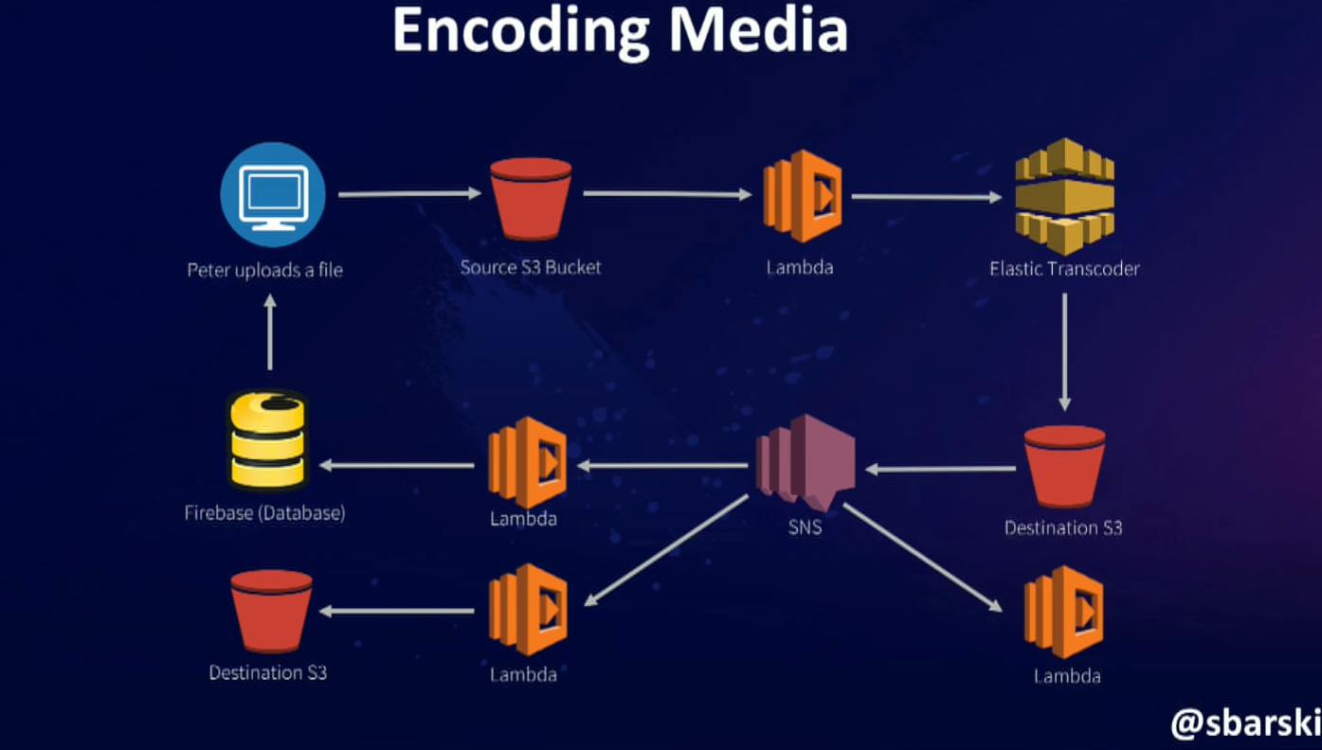
Real life examples
All push based design
Source: Serverless: The future of Software Architecture – Peter Sbarski

Slide 34
IT’S OPEN SOURCE
https://github.com/Azure/Azure-Functions

Slide 35
DEMO TIME

Slide 36


Slide 37


